Slide 1










PROGRAMMING PRESENTATION
by: thobeka sithole

Slide 2




TABLE OF CONTENT
program.cs
constant of a filter class
constant of voice message class
welcome message
voice_message.cs
debug
voice input
try and catch
fliter_questions
if statement
boolen statement
loops in constructor
Tip: Use links to go to a different page inside your presentation.
How: Highlight text, click on the link symbol on the toolbar, and select the page in your presentation you want to connect.

Slide 3
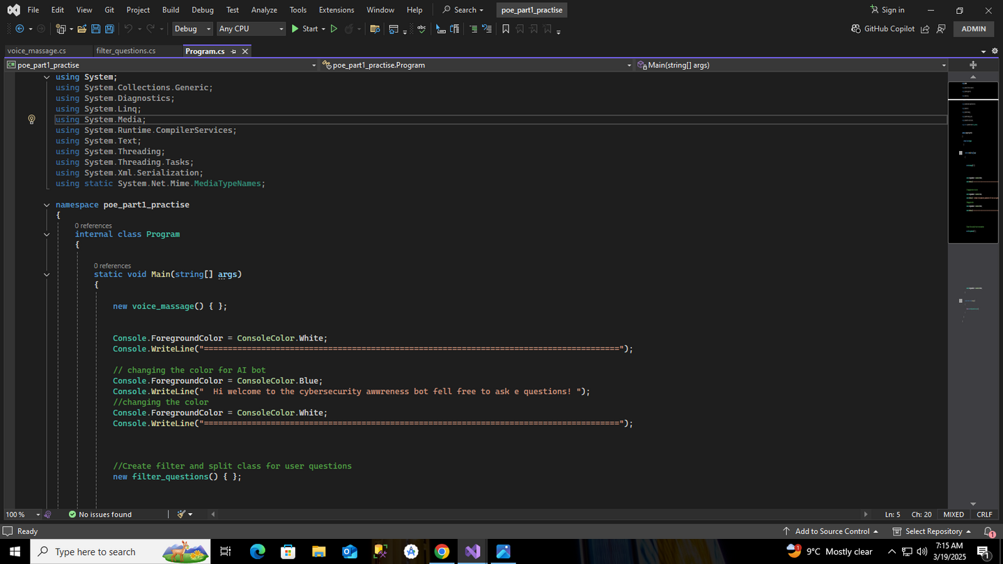



UNDERSTANDING THE C# CONSOLE APPLICATION
Understanding the C# Console Application
This C# console application is part of the poe_part1_practise namespace and serves as a basic chatbot for cybersecurity awareness. The program is designed to interact with users via text-based commands, with potential integration of voice recognition features. It makes use of console color changes to enhance readability and user experience. The main method initializes key components, including the voice_massage and filter_questions classes, which are expected to handle voice-related functionalities and filter user questions, respectively. This project lays the groundwork for a more interactive chatbot, which could be expanded with additional features such as natural language processing and automated response generation.

Slide 4

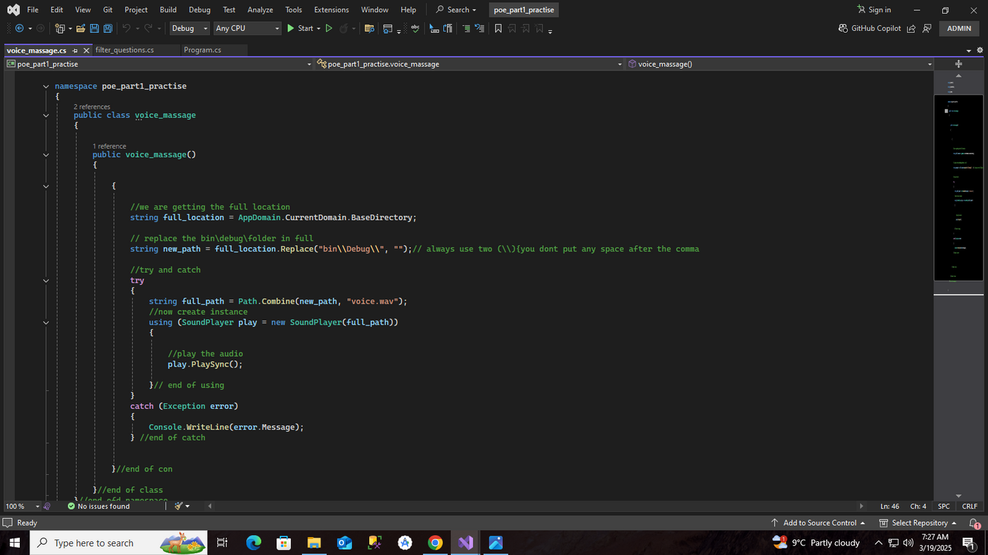
UNDERSTANDING THE VOice_Massage.cs
The voice_massage class in this C# application is responsible for playing an audio file (voice.wav) stored in the application's directory. It retrieves the base directory using AppDomain.CurrentDomain.BaseDirectory and modifies the path to exclude the bin\Debug\ folder. The class then constructs the full path to the voice.wav file.To play the audio file, the class uses the SoundPlayer class from System.Media. Inside a try-catch block, it initializes a SoundPlayer instance with the computed file path and plays the audio synchronously using PlaySync(). If an exception occurs, it is caught and displayed in the console using Console.WriteLine(error.Message).

Slide 5

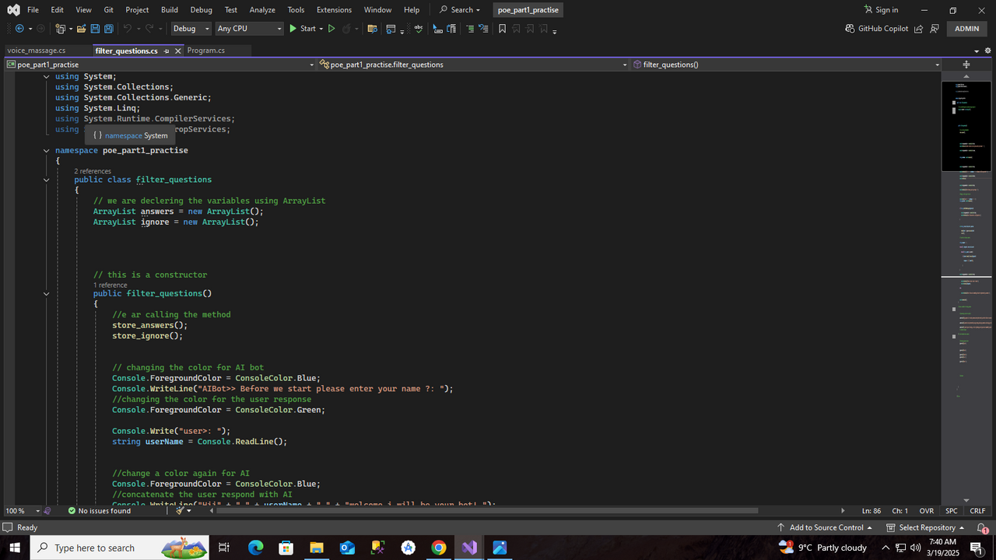
UNDERSTANDING THE FILTER_QUEStions Class in C#
The filter_questions class in C# manages user interactions and filters questions. It uses two ArrayList variables, answers and ignore, to store responses and ignored phrases. The constructor initializes the class and calls methods to populate these lists.
The program changes console colors to distinguish AI responses from user input, enhancing readability. It prompts users for their names and incorporates them into a personalized welcome message. This class is essential for structuring chatbot interactions and can be expanded with advanced filtering techniques for better question handling.

Slide 6
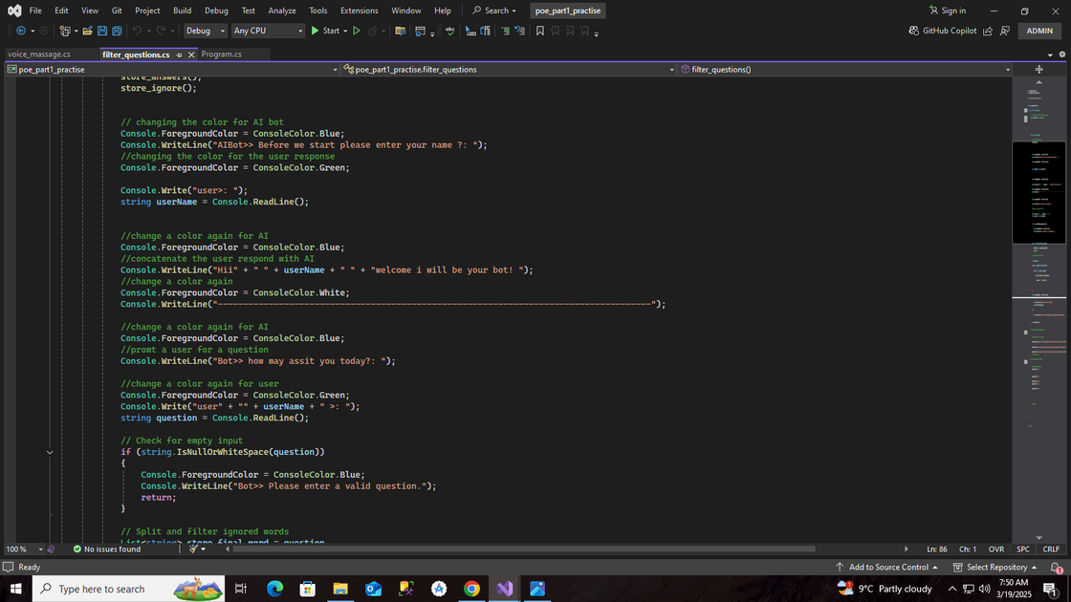
PART 2
This code handles user interaction with an AI chatbot, changing text colors to distinguish AI and user inputs. It prompts the user for their name, greets them, and asks how it can assist. It then validates the user’s question, ensuring it is not empty before proceeding.

Slide 7
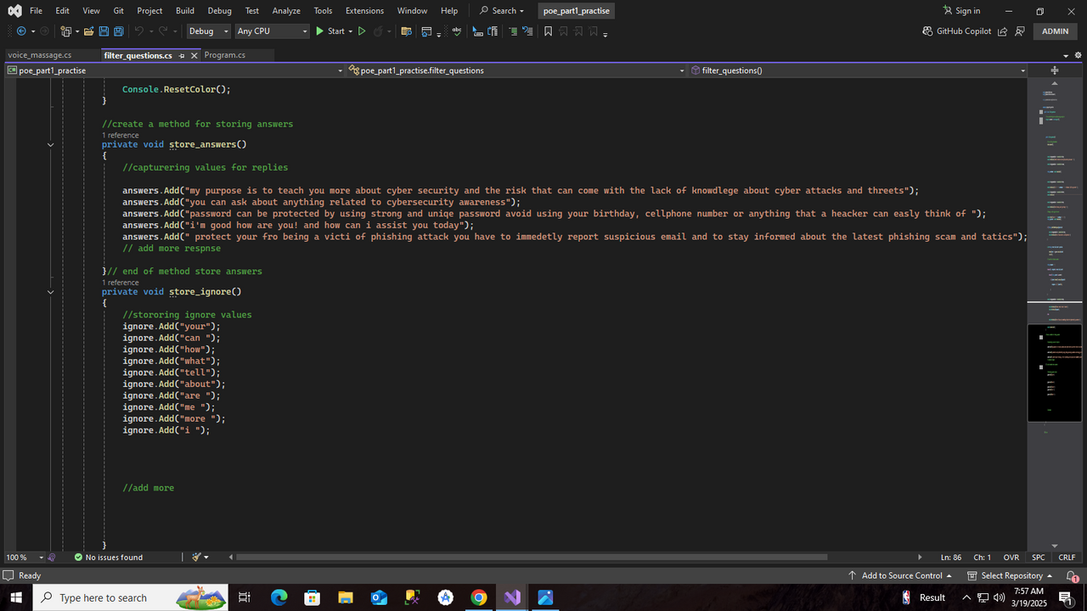
The chatbot is a C# console application designed to provide cybersecurity awareness. It interacts with users by greeting them, asking for their name, and changing text colors for better readability. The chatbot processes user input by filtering out common words (e.g., "how," "what") and matching questions with predefined responses stored in an ArrayList. The store_answers() method contains cybersecurity-related responses, while store_ignore() holds words to be excluded from processing. This simple AI bot enhances user engagement while educating them on online security practices.
PART 3

Slide 8




THANK YOU!

